Slide 1



Dovi Perla
Authentication with JWT for modern web applications

Slide 2
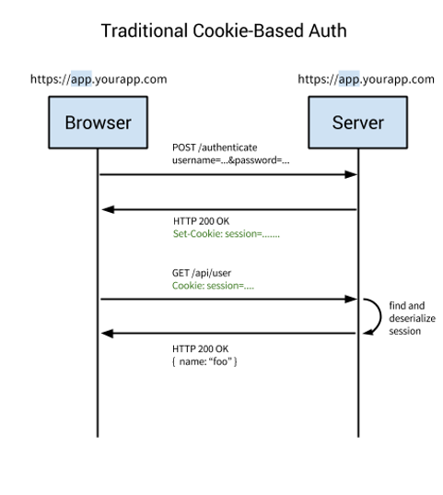
Authentication with session

Slide 3
Disadvantages of Session-Based Authentication
Dependency between the client and server
Sticky cookie
Working with Clusters with sheared database
Urgent calls to database
Extra data saved on Session

Slide 4

JSON Web Tokens
What is JSON Web Token?
Open standard (RFC 7519) that defines a compact and self-contained way for securely transmitting information.
JWTs can be signed using a secret (with the HMAC algorithm) or a public/private key pair using RSA.
Compact: Because of their smaller size, JWTs can be sent through a URL, POST parameter, or inside an HTTP header. Additionally, the smaller size means transmission is fast.
Self-contained: The payload contains all the required information about the user, avoiding the need to query the database more than once.

Slide 5
Advantages of jwt
Micro services architecture
Ability to verify against database or active directory
Avoid having to validate against an active directory every time
Speed and scalability
Managed rules in the token

Slide 6
https://jwt.io/

Slide 7
JSON Web Token structure
Header
type of the token
hashing algorithm
Payload
Reserved claims
iss (issuer), exp (expiration time), sub (subject), aud (audience), and others.
Signature
take the encoded header, the encoded payload, a secret - the algorithm specified in the header, and sign

Slide 8
Roles
Resource Owner: generally yourself.
Resource Server: server hosting protected data (for example Google hosting your profile and personal information).
Client: application requesting access to a resource server (it can be your PHP website, a Javascript application or a mobile application).
Authorization Server: server issuing access token to the client. This token will be used for the client to request the resource server. This server can be the same as the authorization server (same physical server and same application), and it is often the case.

Slide 9
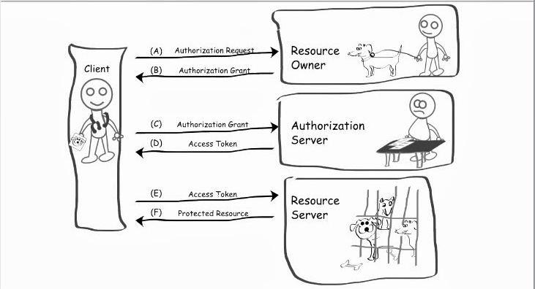

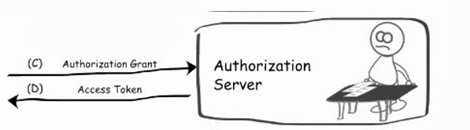

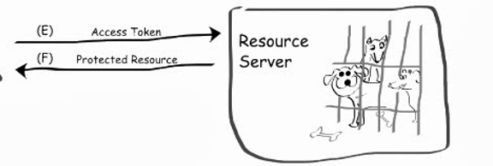
Resource Owner Password Credentials Grant

Slide 11

What is OAuth2?
Version 2 of the OAuth protocol
This protocol allows third-party applications to grant limited access to an HTTP service, either on behalf of a resource owner or by allowing the third-party application to obtain access on its own behalf.

Slide 12
Authorization grant types
OAuth2 defines 4 grant types depending on the location and the nature of the client involved in obtaining an access token.
Authorization Code Grant
Implicit Grant
Resource Owner Password Credentials Grant
Client Credentials Grant

Slide 13
Tokens
Tokens are random strings generated by the authorization server and are issued when the client requests them.
Access Token
Refresh Token
Scope is a parameter used to limit the rights of the access token.

Slide 14

External login
Refresh Token
Two Factor
https://auth0.com/

Slide 15
Refresh Tokens - Benefits
Updating access token content
Revoking access from authenticated users
No need to store or ask for username and password

Slide 16
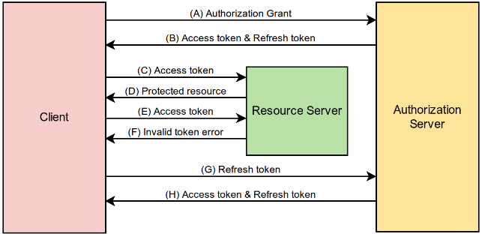
Refresh Tokens - Architecture

Slide 17
Summery
JWT provide new way to authentication and authorization users in web apps
New client web apps working against the web api’s to consume data
We protect the web api resources with access token and refresh token are kept in saved cookies

Slide 18


